Slide 1
TCP报文段格式

Slide 2
TCP: Overview RFCs: 793, 1122, 1323, 2018, 2581
point-to-point:
one sender, one receiver
reliable, in-order byte steam:
no “message boundaries”
pipelined:
TCP congestion and flow control set window size
send & receive buffers
full duplex data:
bi-directional data flow in same connection
MSS: maximum segment size
connection-oriented:
handshaking (exchange of control msgs) init’s sender, receiver state before data exchange
flow controlled:
sender will not overwhelm receiver

Slide 3
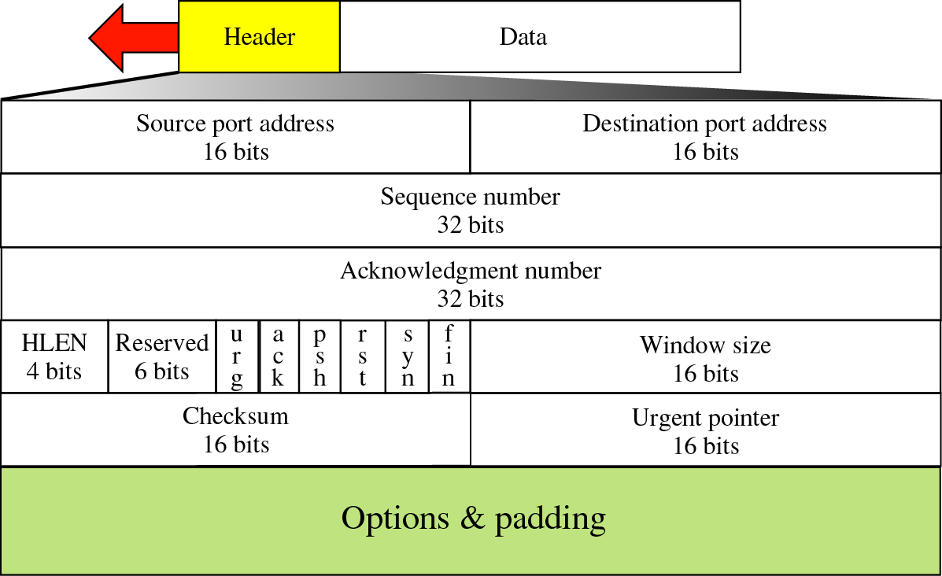
TCP segment structure

Slide 4
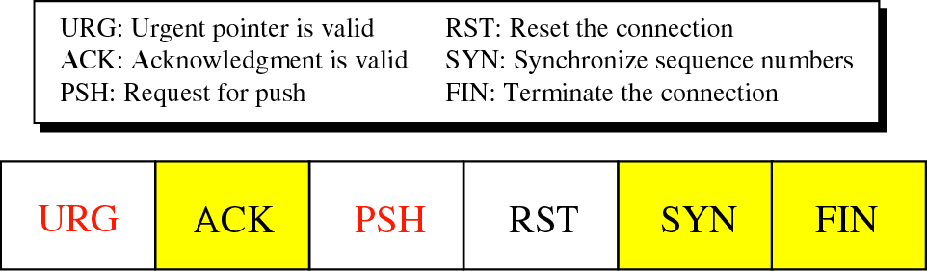
TCP segment structure - Control field

Slide 5
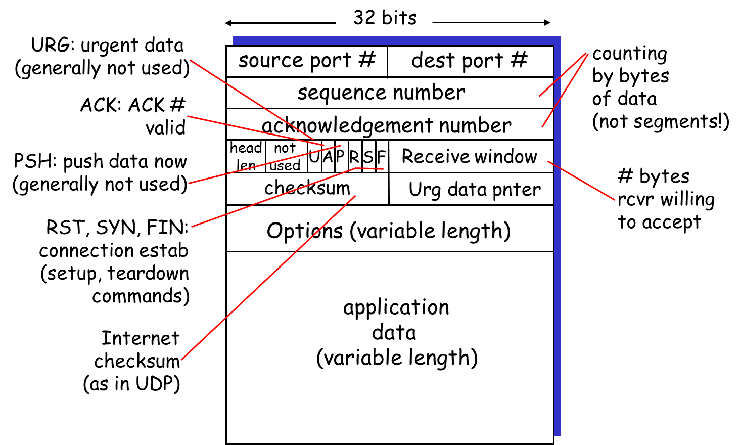
TCP segment structure

Slide 6
TCP seq. #’s and ACKs
Seq. #’s:
byte stream “number” of first byte in segment’s data
ACKs:
seq # of next byte expected from other side
cumulative ACK
Q: how receiver handles out-of-order segments
A: TCP spec doesn’t say, - up to implementor

Slide 7

TCP seq. #’s and ACKs
Host A
Host B
User
types
‘C’
seq=42, ack=79, data = ‘C’
host ACKs
receipt of
‘C’, echoes
back ‘C’
seq=79, ack=43, data = ‘C’
host ACKs
receipt
of echoed
‘C’
seq=43, ack=80
simple telnet scenario

Slide 8

Summary
TCP segment structure
TCP seq. # and ACK #

